Slide 1
Software Architecture Assignment(SEZG651/SSZG653)
SAQUIB
2021MT12266@wilp.bits-pilani.ac.in

Slide 2
Purpose of the System
Currently, ABC.com videos are available on multiple channels hosting platforms like YouTube CloudFront and Kaltura.
Each hosting platform has unique data model to represent a video entity.
Design a micro-service to manage video metadata across multiple hosting platforms that has a generic and scalable data model and capabilities to support video metadata management for these hosting platforms.

Slide 3
Key Requirements : Functional & Non-Functional
Functional requirements | Non functional requirements
Video API support multiple hosting platform. Store metadata against each video. If the subscriber in not logged in the client should not pass user id in the req. Video API should return all details related to video like format ,length, profile etc. For the premium video check for the authenticated paid subscriber and then return the data. If the content is public just return the response to subscriber without checking the authentication. | API Response time within 0.1ms seconds System should support thousand request per sec. Automatic & Elastic Scaling Logging & Monitoring Security Maintainability Usability

Slide 4
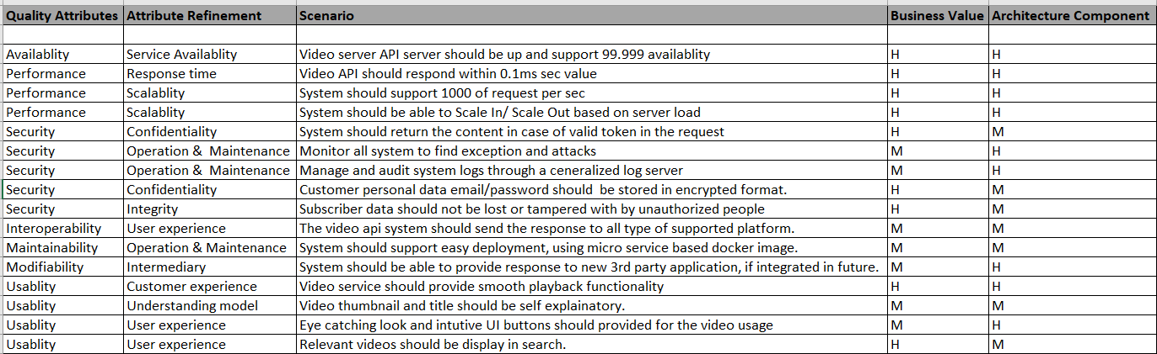
Utility Tree

Slide 5
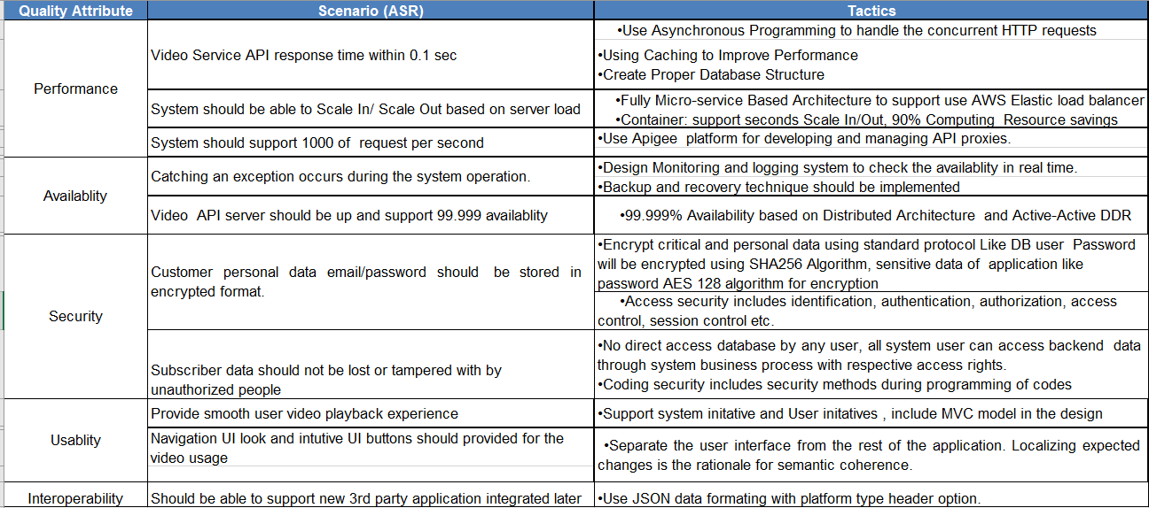
Tactics used to achieve the top 5 ASRs

Slide 6
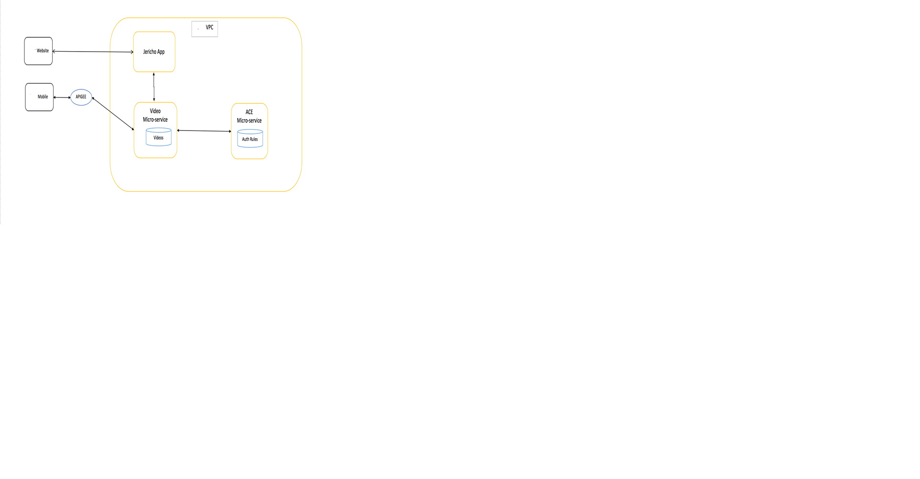
Context Diagram

Slide 7
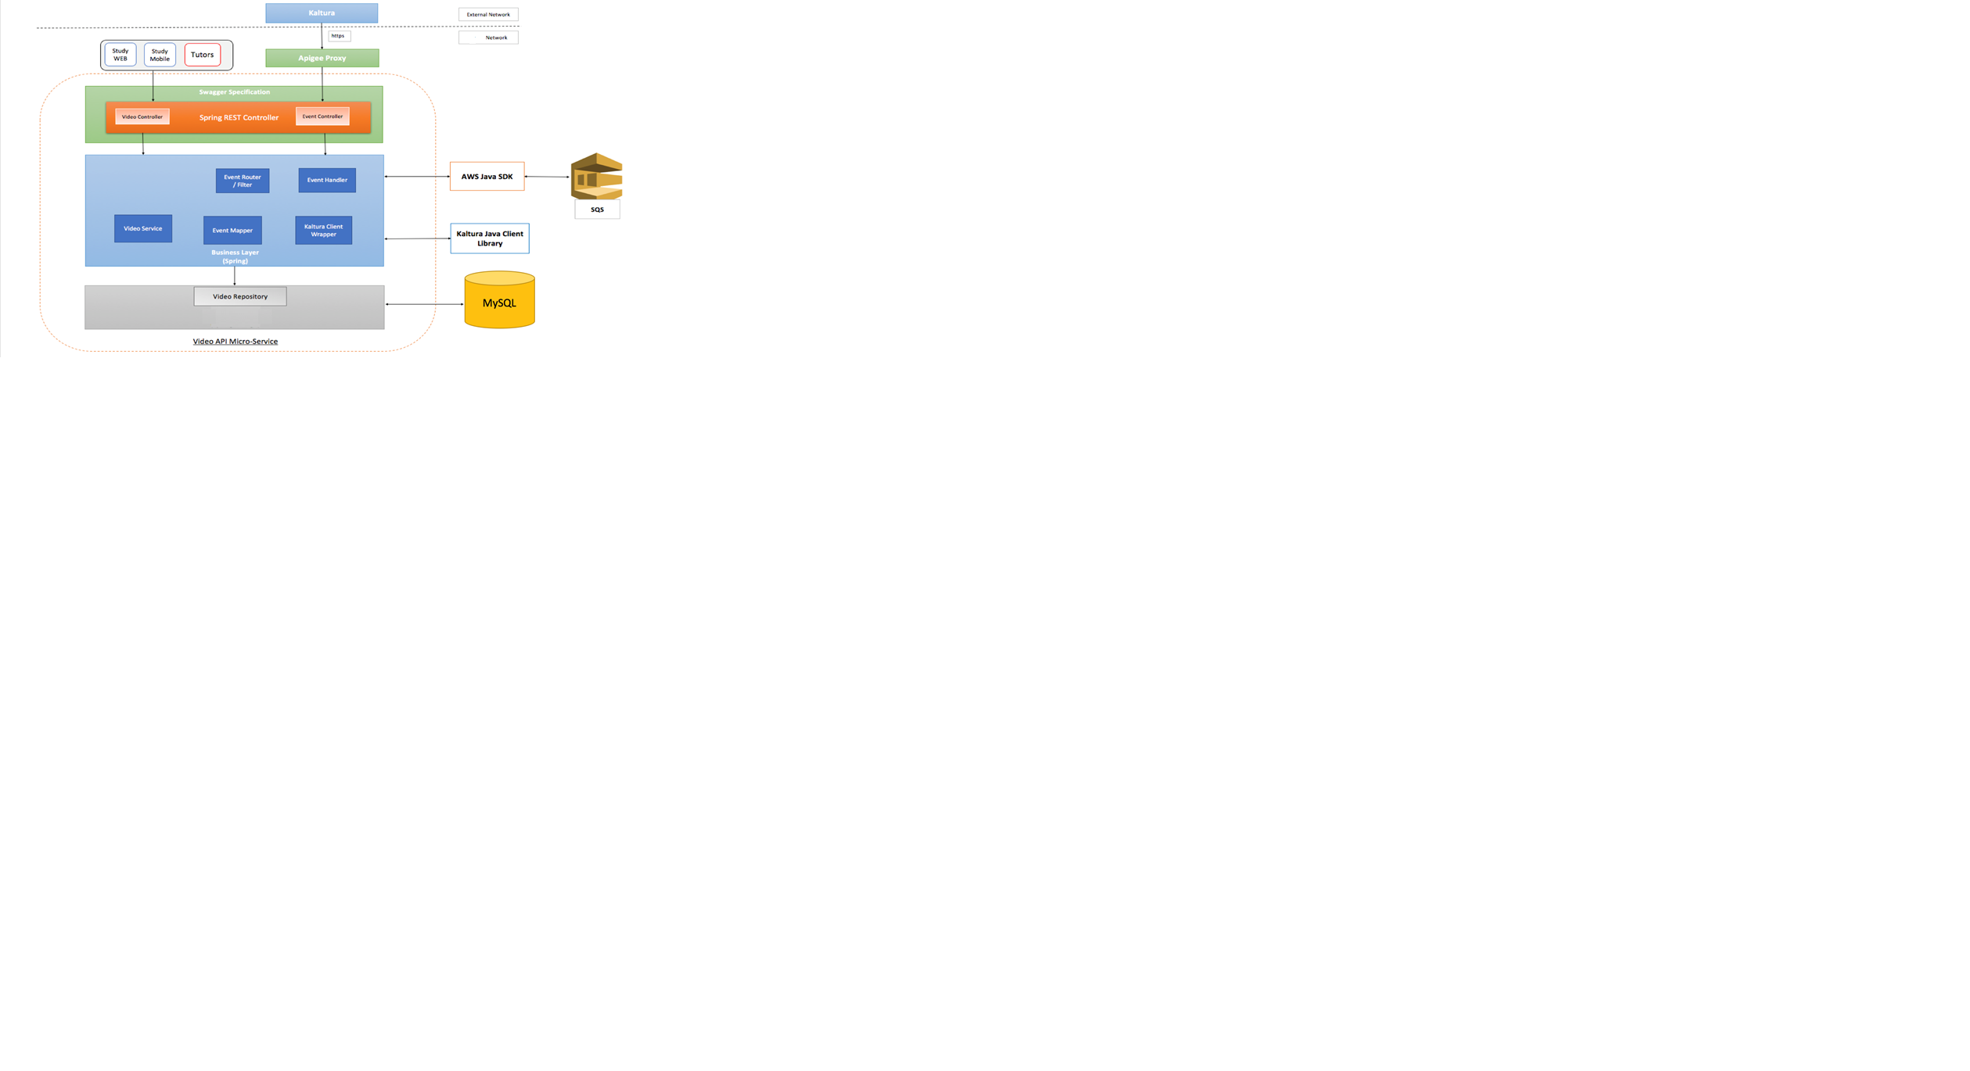
Module Decomposition Diagram

Slide 8
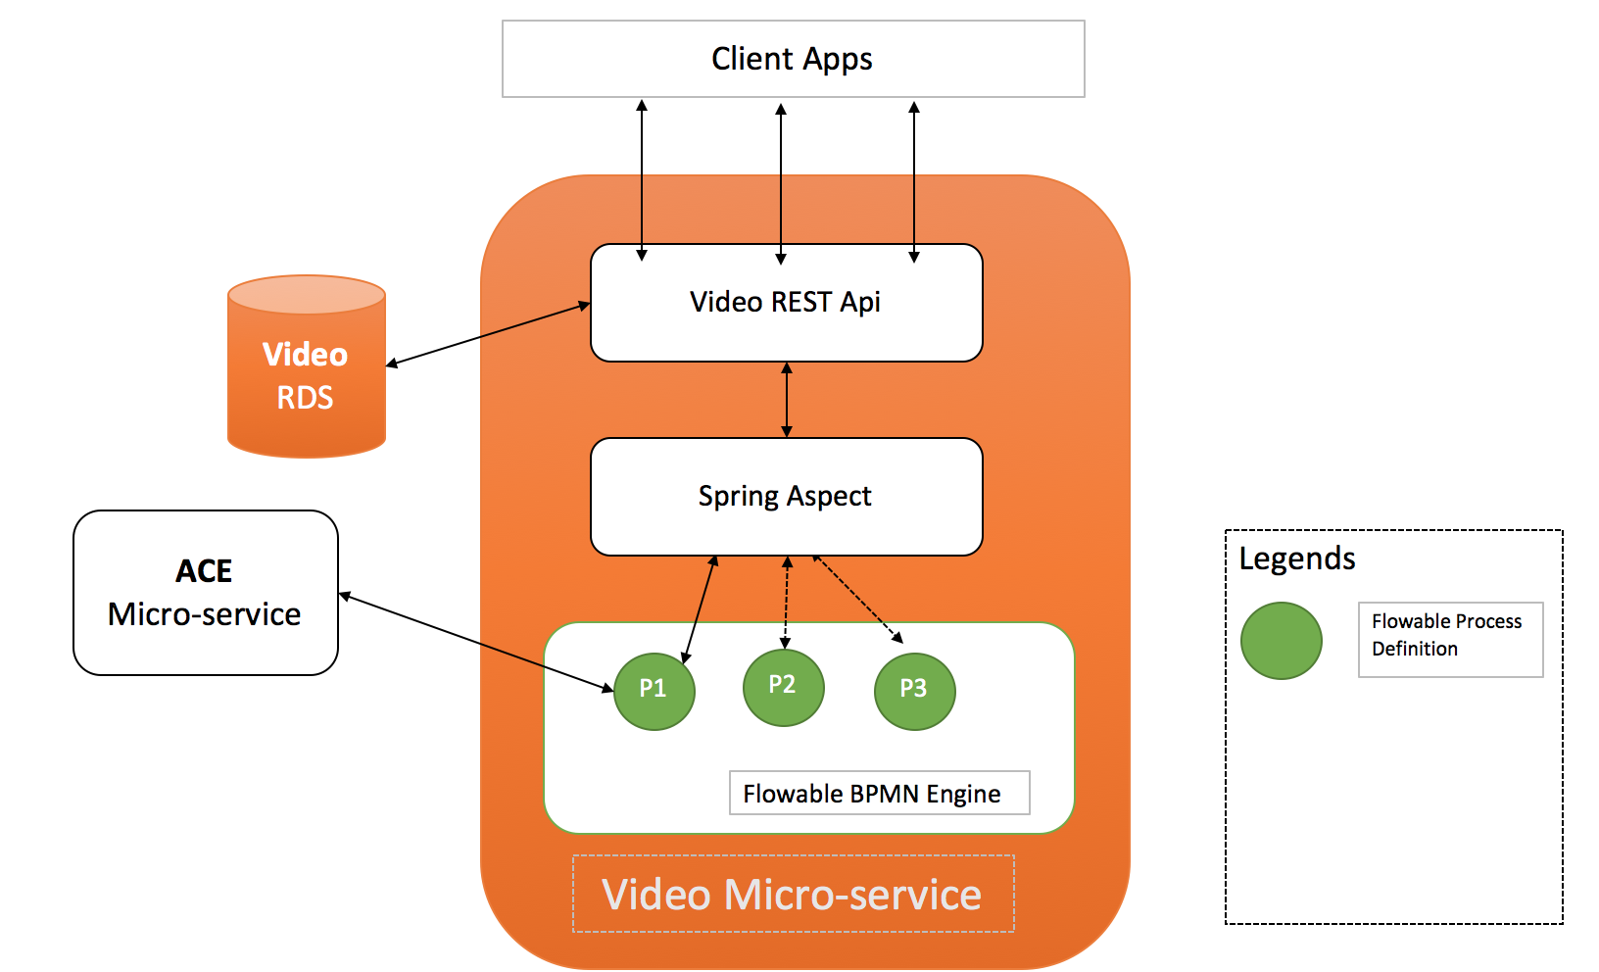
Component and Connector Diagram

Slide 9
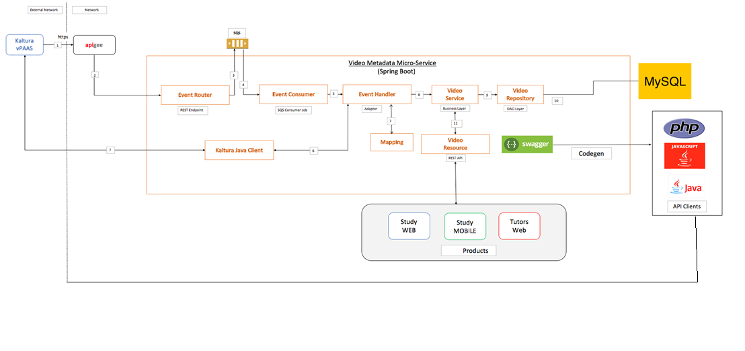
Deployment Diagram

Slide 10
System Working
Kaltura would post events for newly published videos to APIGEE proxy layer(https) with authentication key in header and event object in payload.
APIGEE will forward events to Event Router which is a REST endpoint that accepts event object in JSON format.
Event router will publish the events received as is to an Amazon SQS Queue. Before publishing, event router will apply filtering logic to filter out events based on business use case.
Event consumer will poll the Amazon SQS Queue for events.
Event consumer will forward events received from Amazon SQS Queue to Event handler which will parse the event based upon the type of event.
Event handler will retrieve custom metadata information from Kaltura using Kaltura's Java Client library.

Slide 11
System Working
Event handler will transform the custom metadata information of video into Video-Metadata Micro-service object model based upon mapping rules.
Event handler will then forward the video metadata object to business layer for persisting metadata object.
Business/Service layer will apply any business validations and pass the metadata object to repository layer.
Video repository will persist the metadata object into MySQL data store.
Video resource would provide access to video-metadata stored in MySQL data store over REST API. The REST API could be used by various ABC.co products.

Slide 12
Key Learnings
Personally , I got the basic idea about what is utility tree and how to create it.
Got the idea of how Availability, modifiability, Performance, Security scenario tactics used practically.
Identify different type of diagram like context, module, deployment diagram etc.
On personal experience, If the architecture is properly design , it help us to understand the project easily and enable to speed up the development activities.
It help us to see the reduce the risk factors, analyze the cost of the project ,and identify other critical requirement which might be overlooked if the architecture not design properly.
By designing proper architecture, all quality attributes can be taken care which led us to deliver customer centric, aligned with business requirement project.

Slide 13
THANK YOU

